Slide 1
19CS3113S
Analysis and Design of Algorithms
STRING MATCHING
Session-6

Slide 2
String Matching
Text-editing programs frequently need to find all occurrences of a pattern in the text.
Given a text is an array T[1..n] of length n and a pattern P[1..m] of length m<=n.
We say that pattern P occurs with shift s in text T if 0≤s≤ n-m and T[s+1..s+m] = P[1..m].
If P occurs with shift s in T , then we call s a valid shift; otherwise, we call s an invalid shift.

Slide 3
String Matching
The string-matching problem is the problem of finding all valid shifts with which a given pattern P occurs in a given text T .
Example: T = ababcabdabcaabc and P = abc, the occurrences are:
  first occurrence starts at T[3]
  second occurrence starts at T[9]
  third occurrence starts at T[13]

Slide 4
Applications:
  Searching keywords in a file
  Searching engines (like Google and Openfind)
  Database searching (GenBank)

Slide 5
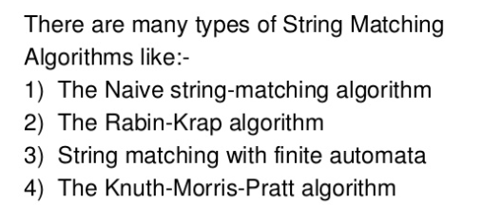

Slide 6
The naive string-matching algorithm
The naive algorithm finds all valid shifts using a loop that checks the condition
P [1..m] = T[s+1..s+m] for each of the n-m+1 possible values of s.

Slide 7
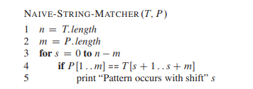
Algorithm

Slide 8
Running Time
At every step, after ‘m’ comparisons a match/mismatch will be found.
These ‘m’ comparisons will be done for (n-m) characters in T.
Thus, the running time obtained is (n-m)m + m.

Slide 9
Example
T :
P :
a b c a b d a a b c d e
a b d

Slide 10
Example ( Step – 1 )
T :
P :
a b
c a b d a a b c d e
a b
d
Mismatch after 3 Comparisons

Slide 11
Example ( Step – 2 )
T :
P :
a b c a b d a a b c d e
a b d
Mismatch after 1 Comparison

Slide 12
Example ( Step – 3 )
T :
P :
a b c a b d a a b c d e
a b d
Mismatch after 1 Comparison

Slide 13
Example ( Step – 4 )
T :
P :
a b c
a b d
a a b c d e
a b d
Match found after 3 Comparisons
Thus, after 8 comparisons the substring P is found
in T.

Slide 14
Find whether pattern exists in the text or not using naïve string matching algorithm
T :
P :
a b c
a a d
c a b a d e
b a d

Slide 15
Thank you

